Slide 1
How To Negotiate
Your First Contract
January 25, 2024
9:00 – 10:00 am
Arkes 6 Video Conference Room
Jesse Meyer
Vice President, Operations

Slide 2
How To Negotiate Your First Contract
Topics for today’s session
Faculty recruitment process
Elements of an offer letter and employment agreement
Compensation
Work RVUs and other metrics
Other considerations
Q&A

Slide 3
How To Negotiate
Your First Contract
Understanding the elements and how they impact you
(*some elements are negotiable)

Slide 4
How To Negotiate Your First Contract
Faculty recruitment process: NM example
Submission
Approval
Search
Offer
Start
Replacement or growth
Search committee
Offer approval and acceptance
NMG business plan
On-site interviews
Employment agreement
NU pre-search
Candidate identification
License and credentialing
2 months between business plan development and approval
3+ months for search
4+ months between offer acceptance and start

Slide 5
How To Negotiate Your First Contract
Elements of an offer letter
Faculty Appointment
Responsibilities
Compensation
Benefits
Rank
Clinical:
inpatient service
Base (annual) salary
Medical/dental/vision
Track
Clinical:
outpatient clinic
Signing bonus
Paid time off
Duration
Clinical: OR
Annual bonus
Retirement
Clinical: call coverage
Total comp
Tuition
Education & teaching
Guarantee period
Professional development
Research program & funding
Roles with funded effort
Moving expenses
Duties at system
hospitals/affiliate sites
Elements that may be negotiable

Slide 6
How To Negotiate Your First Contract
Elements of an employment agreement (contract)
After the offer letter is accepted, the candidate will receive an employment agreement (contract), which specifies elements of the offer letter and includes some additional elements
Compensation
Clinical Responsibilities
Term, Renewal, & Termination
Malpractice Coverage
Covenant Not To Compete
Example:
For term of agreement plus 2 years, within X miles of main hospital and any affiliate site which represents Y% of clinical activity
Note: you may be able to earn a relatively small amount of compensation for efforts unrelated to your employment agreement (e.g. for external consulting arrangements) but you should ensure that these efforts are known to your employer and that you have disclosed the arrangement as appropriate/relevant.

Slide 7
How To Negotiate Your First Contract
Compensation plan example: Clinician Educator
EXAMPLE – NOT ACTUAL DATA
Base Salary
Clinical Bonus
Total Cash Compensation

Slide 8
How To Negotiate Your First Contract
Compensation plan example: a deeper dive
EXAMPLE – NOT ACTUAL DATA
FTE = Full Time Equivalent; a full-time position is a 1.0 FTE
Clinical FTE = portion dedicated to clinical care
CFTE = 1.0 – 0.1 ATC – 0.05 APD = 0.85
$/wRVU rates
Work RVU (wRVU) values
Comp benchmarks are typically based on total comp, not base salary
Base salary, bonus, and total compensation may be guaranteed for a period of time per your contract.

Slide 9
How To Negotiate Your First Contract
Compensation plan: $/wRVU annual review process
NMG manages an annual process to ensure that physician compensation remains competitive relative to benchmarks, by specialty
Dec/Jan:
Benchmarks* are refreshed
March/April:
Rate reviews and modeling
If warranted, adjustment to wRVU value is made for the following fiscal year
*Productivity and compensation benchmark calculations:
Specialty-specific, nation-wide
Sources for Benchmarking include Sullivan Cotter, Medical Group Management Association, and Association of American Medical Colleges (AAMC)

Slide 10
How To Negotiate Your First Contract
Work RVUs: overview
A work RVU (relative value unit) is the relative level of time, skill, training and intensity to provide a given clinical service.
wRVUs are assigned for each CPT code by the Centers for Medicare and Medicaid Services (CMS) and are consistent across geographic areas, institutions, and specialties.
Surgery Work RVU Examples
Procedure | Type | CPT | wRVU per billed unit
New patient office visit, 45-59 mins | Evaluation & Management | 99204 | 2.60
Laparoscopic inguinal hernia repair, initial | Surgery* | 49650 | 6.36
Laparoscopic cholecystectomy | Surgery* | 47563 | 11.47
Laparoscopic gastric bypass/roux-en-y | Surgery* | 43644 | 29.40
Laparoscopic colectomy with removal of terminal ileum and ileocolostomy | Surgery* | 44205 | 22.95
*inpatient and outpatient visits related to the procedure within 90 days of the surgery’s date of service are included in the surgery wRVU per billed unit. Also known as the global period.

Slide 11
How To Negotiate Your First Contract
Work RVUs: benchmarking
To compare actual work RVUs to benchmarks (for academic faculty), use the CFTE-prorated benchmark for your specialty
EXAMPLE – NOT ACTUAL DATA
Academic Faculty wRVU Benchmarks | 25th percentile | 50th percentile | 75th percentile
General surgery: 1.0 CFTE | 5,000 | 6,000 | 7,000
General surgery: prorated for 0.85 CFTE | 4,250 | 5,100 | 5,950
You should receive regular (monthly) reports of your wRVUs
Ideally, you would have access to a tool which allows you to see the impact of your billed wRVUs on your total compensation

Slide 12
How To Negotiate Your First Contract
Performance metrics
Patient Access
Work
RVUs
Teaching and mentorship
Patient Engagement (Satisfaction)
OR Procedures & Utilization
Academic progress toward promotion
Research Funding

Slide 13
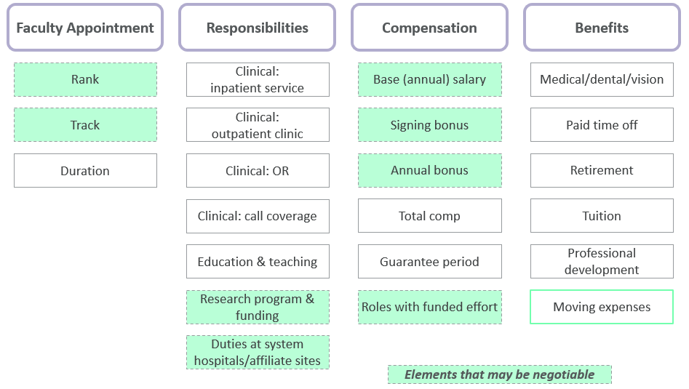
How To Negotiate Your First Contract
Other considerations
Negotiating
Negotiating is ok and signals interest and engagement
Consider which elements of the offer/contract may be negotiable
Know when to stop negotiating (accept or walk away)
Don’t accept unless you intend to honor the commitment

Slide 14
How To Negotiate Your First Contract
Other considerations
Negotiating
Negotiating is ok and signals interest and engagement
Consider which elements of the offer/contract may be negotiable
Know when to stop negotiating (accept or walk away)
Don’t accept unless you intend to honor the commitment
Non-contract elements
What does success look like in 1 year, 3-5 years, 10 years?
What is your comfort level with leadership and organizational culture? Did you get a positive impression from team members?
Is there an opportunity for leadership development/roles?
Warning Signs
Unclear delineation of responsibilities (clinical, education, research, other)
Too good to be true: high compensation relative to market – is it sustainable? Are responsibilities reasonable/manageable?
Unclear what happens after the initial compensation guarantee
Various indicators of a negative culture or work environment

Slide 15
Questions?

Slide 16
Thank you
Jesse Meyer
Vice President, Operations
Northwestern Medicine
211 E Ontario, Suite 1600
Chicago, Illinois 60611
312-926-5350 office
773-531-3690 cell
jmeyer@nm.org

