Slide 1


A Presentation
on How to Give
A Presentation
Kimberly B Golisch MD MS

Slide 2




The Process
Submitted Abstract
Abstract Accepted
It’s Showtime
NQUIRES Northwestern Quality Improvement, Research, & Education in Surgery
Notes:
1. You have a project and you wanted to present your work in progress, you found a relevant conference to submit to. Now 3–4 months you get that acceptance email and uh oh now it’s showtime .. You’re panicking! How to turn words on a paper into an engaging, inspiring presentation? Well that’s why you’re here today

Slide 3



Audience
Mentor
Who
Present Material
Accordingly
Preferences &
Template
NQUIRES Northwestern Quality Improvement, Research, & Education in Surgery
Notes:
Just like for the presentation you will be making I like to think about it as a general overview first. So let’s go over the 5 W’s of who what where when why. Staring with the who. You’re going to want to think about 2 main who’s in this. First, your audience. This will help you frame the presentation at the appropriate level. This is both at the conference and the session level. When you get your acceptance you are assigned a session. For example, I had a implementation study project for hepatocellular carcinoma. This could’ve gone into a cancer session, an implementation or QI session, or what it did get assigned a HPB session. Knowing this gives you the information for how to structure your paper. The background can be less on HPB specifics and probably needs a little more about how we did the study and why. Whereas if it were in an implementation session with a range of clinical specialties, pointing out the importance of low rates of HCC would need to emphasized more thoroughly.

Slide 4
Audience
Mentor
Who
Present Material
Accordingly
Preferences &
Template
NQUIRES Northwestern Quality Improvement, Research, & Education in Surgery
Notes:
Then the second and third who’s are your mentor and your/their program. As you can see my NQUIRES footer here. I’ve also given presentation with the SECOND trial template. As well as the Illinois Surgical Quality Improvement Collaborative and the transplant team’s NTORC. Additionally, I would touch base with your mentor to see if they have a specific template they like to use or a specific style or preferences. Or if the conference is requiring a specific template. Everyone is different and you don’t want to go through the effort and time of making an entire presentation to then have to redo it.

Slide 5



Statewide Quality Improvement Collaborative to Improve
Venous Thromboembolism Prophylaxis after
Abdominopelvic Cancer Surgery:
A Mixed-Method Study
Kimberly B. Golisch, Casey M. Silver, Ying Shan, Andres Guerra, Lauren M. Janczewski, Jeanette Chung, Brianna D’Orazio, Julie K Johnson, Vivek N Prachand, Michael F. McGee,
David D. Odell, Anthony D. Yang, Karl Y. Bilimoria, Ryan P. Merkow
@BrookeTheOstomy

Slide 6
Pilot for Semi-Automated System-Wide Clinical Care Pathway for HCC Screening for Cirrhosis
Kimberly B Golisch MD MS, Julianna M Doll BA, Jennifer E Bannon MS BSN, Amelia E Van Pelt PhD MPH, Alexander A Huang BS, Urvi Thakkar MEng MBA, Marty Ghosh MBA, Blair Parker MS, Justin Boike MD, Vinayak S Rohan MD,
Daniela P Ladner MD MPH

Slide 7




“Uphill in the snow both ways”
Shoveling a Path between Generations in the Surgical Environment
Kimberly B Golisch, Michael R Visenio, Suhail Zeineddin, Benjamin Pitt,
Daniela Amortegui, Natalia Mackiewicz, Patricia L Turner, Karl Y Bilimoria,
Julie K Johnson, Yue-Yung Hu
@BrookeTheOstomy
@The_SECONDTrial

Slide 8


Presentation
Poster
Who
What
Quick-shot
Full
Printed vs E-poster
Formal vs on display
NQUIRES Northwestern Quality Improvement, Research, & Education in Surgery
Notes:
The next step is clarifying the what. When you get the acceptance it will include if it is a poster or a presentation which is the first big divide. For presentations it will then likely specify if it is quick-shot presentation or a full oral. Each conference has different definitions of what these mean. Quick-shots are often 3-5 minutes with 5-10 slide maximum. Specifically for ASC they are 3 minute presentations with 5 slide limit. I’ll talk more in the slide presenting section on how to find loopholes to the slide limit. Full orals have a much wider range. ASC they are 8 minutes. Other conferences or keynotes or plenary presentations may be more 10-30 minute range.

Slide 9
Presentation
Poster
Who
What
Quick-shot
Full
Printed vs E-poster
Formal vs on display
NQUIRES Northwestern Quality Improvement, Research, & Education in Surgery
Notes:
Or is it a poster acceptance? Then the next step is figuring out if it’s a poster session where you’ll be assigned a time and you’ll formally present to a group. Or if it’s a poster session where you’ll hang it up and it’s less formally presented where people stop by the stations they’re interested in. This will help you again frame your presentation accordingly.

Slide 10
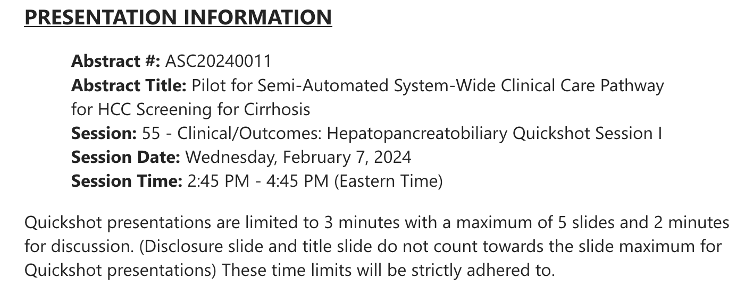
Oral Presentation - Quickshot
Notes:
For an example this is what shows up with the ASC acceptance for quickshot. For the 5 slide limit, you can add animations, layer text, etc to keep under 5 slides. Also check with mentors because they tend to care about time more than number of slides. But some conferences may be more strict.

Slide 11
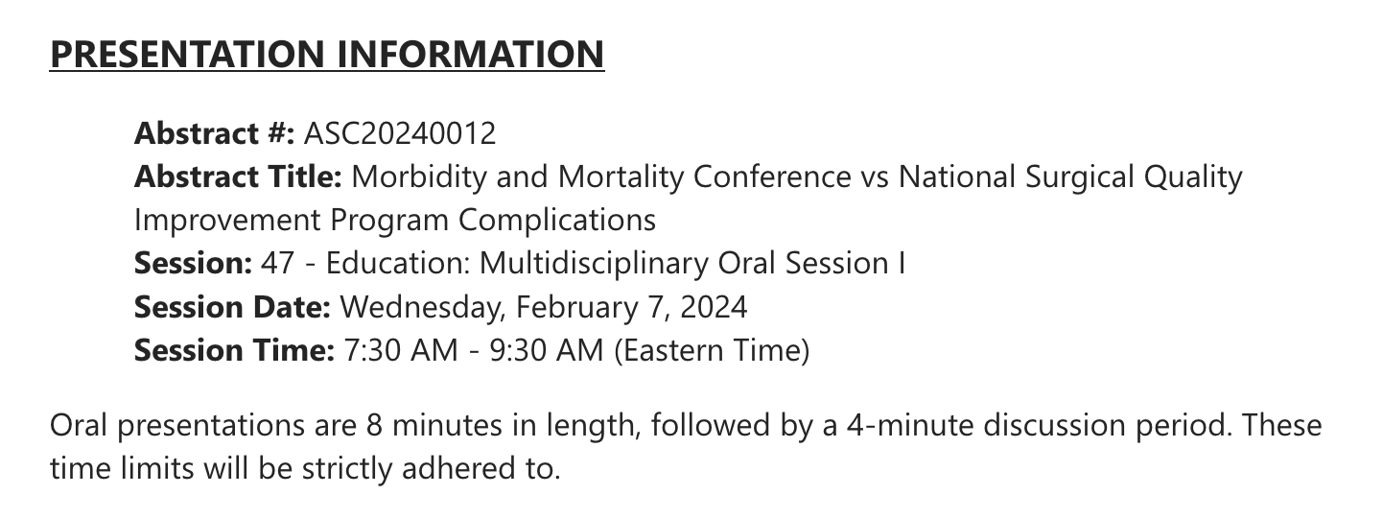
Oral Presentation- Full
Notes:
This is for oral. You can see slightly different. This doesn’t have a slide limit.

Slide 12




The Process
Location
Who
What
Where
Upload
Print
Conference
Room
NQUIRES Northwestern Quality Improvement, Research, & Education in Surgery
Notes:
You also need to think about the where’s. to get technical, first is where you are going to submit you presentation. There should be instructions on this. Sometimes they give dates you need to upload it to their system by. So if it’s an e poster or presentation it may be that. Sometimes you can do that or you can upload it in the conference speaker ready room the day before or a at least a few hours before the day of. So this is something to think about when planning your flight. If you’re going the day of or late the night prior you may want to aim to do the online submission instead. And then if it’s a physical poster figure out how and where you are getting it printed and realize it can take a few days to a week to process that so plan accordingly. For location, go see where your talks are. It’s also helpful to know if there will be a presenter mode so you can plan how you’re memorizing the entire presentation vs bringing notes with you vs having notes on the screen

Slide 13


Practice
Sessions
Who
What
Where
When
Timing, content,
pace
Support each other!
NQUIRES Northwestern Quality Improvement, Research, & Education in Surgery
Notes:
Practice makes perfect! It should not be your first time going through the entire presentation on presentation day. It is quite obvious when that is the case. We don’t want to be those people. A good route to go is making the presentation and sending it, with your script, to the senior author for the project. They’ll edit for content. Then next step is to run through it and have someone time you. Then make edits accordingly. Then go to a session through your lab if you can where you run through it in front of multiple people. Ex/ NSQIRES we have sessions with other research fellows and even some non-physicians. We do the full presentation then we do line by line basically. It’s very, very thorough. Ideally this should be 1-2 weeks prior to the presentation so you have time to make your final edits. This also helps if you’re a procrastinator like me, this ensures you cannot. So then you’re also ready for that upload deadline etc. You often will go to conferences with your peers so having a central list where others are presenting is really helpful so you can bounce around from presentation to presentation.

Slide 14
M&M
NSQIP
Who
What
Where
When
Why
NQUIRES Northwestern Quality Improvement, Research, & Education in Surgery
Notes:
So why is any of this important? Why do we need to be so detailed?

Slide 15
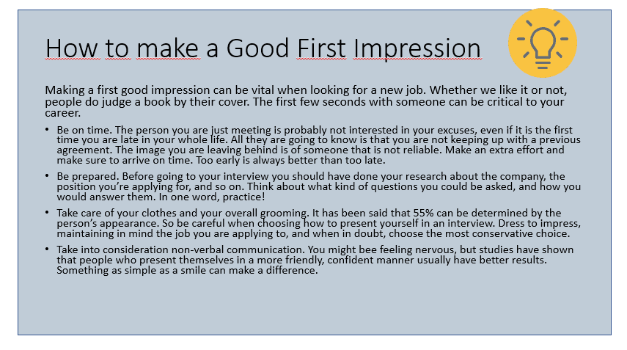
M&M
NSQIP
NQUIRES Northwestern Quality Improvement, Research, & Education in Surgery
Notes:
So why is any of this important?

Slide 16
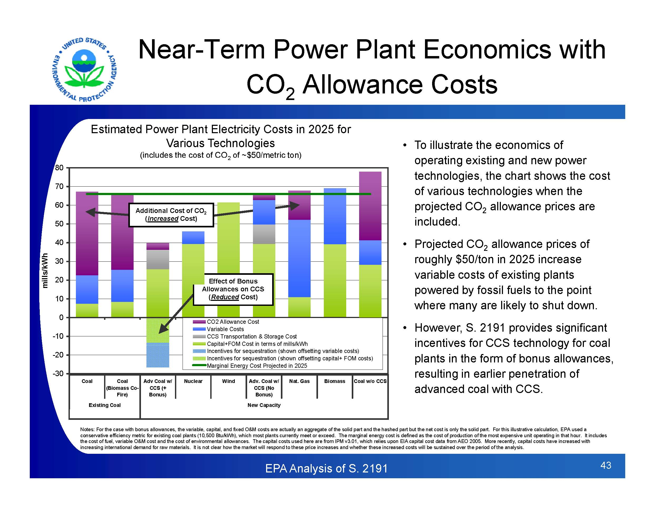
M&M
NSQIP
NQUIRES Northwestern Quality Improvement, Research, & Education in Surgery
Notes:
So why is any of this important?

Slide 17
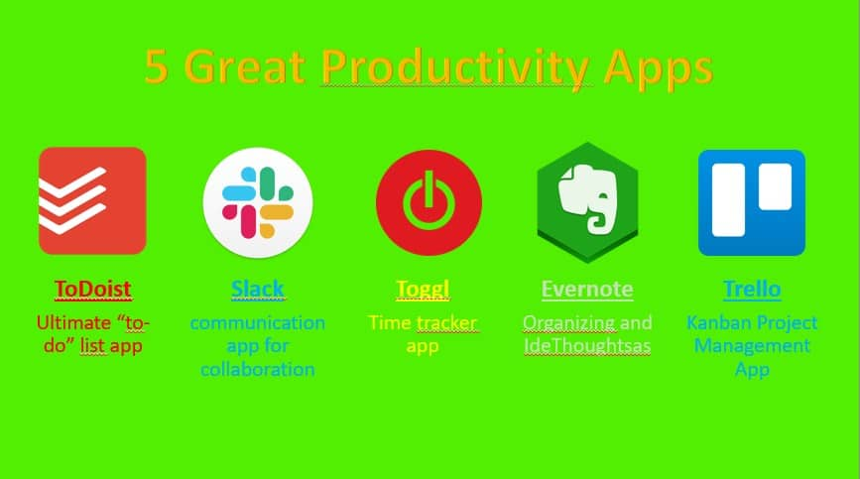
NQUIRES Northwestern Quality Improvement, Research, & Education in Surgery
Notes:
So why is any of this important?

Slide 18

Stylistic Tips
NQUIRES Northwestern Quality Improvement, Research, & Education in Surgery
Notes:
So why is any of this important? Why do we need to be so detailed?

Slide 19






Funding & Disclosures
Surgical Education Culture Optimization through targeted interventions based on National comparative Data
National Institutes of Health's training grant 5R38CA245095
AHRQ K08HS29532
Notes:
This project is supported by the following institutions and grants

Slide 20



Generations & Med Ed
Generational differences (GD) → miscommunication and misunderstanding in the workplace
Topic of interest in many fields of medical education
Limited knowledge how GD are perceived in
general surgery
Talmon Adv Med Educ Pract 2021
Pulcini Pediatrics 2021
Pascarella JSR 2023
Notes:
It has been hypothesized that generational differences may lead to misunderstanding in the workplace. Thus, it has become a topic of interest in many fields of medical education. However, little is known about how generational differences are perceived in general surgery.

Slide 21


Objective
We sought to characterize the role generational differences play in the surgical training environment
Notes:
The aim of this qualitative study was to characterize the role generational differences play in the surgical training environment

Slide 22


Methods
15 General Surgery Program Tours
103 Interviews & Focus Groups
32 Trainees and 71 Faculty
Inductive & Deductive Reasoning
Constant Comparative Approach
Notes:
Through the SECOND trial, 15 site visits were done to general surgery residencies. 103 interviews encompassing responses from 32 trainees and 71 faculty were included. Data was analyzed deductively, using previously described characteristics of older vs younger generations, and inductively, using constant comparative approach.

Slide 23
Back in my Day
Trust the
process
Pride in prioritizing work
Less formal hierarchy → worse education
“There was a lot of pride…some of our chiefs said, "Yeah, my wife gave birth and I was in the OR and I just went afterwards"…
"I haven't seen my kid for a week”
Division Chief
Notes:
Results included three overarching themes, first, older generation surgeons who described trusting in the training process, taking pride in prioritizing work to the point of personal sacrifice, and believing a less formal hierarchy may lead to worse education. One representative quote about work prioritization is a division chief describing how there was pride in being the hospital constantly, even around be life events. “yeah my wife gave birth and I was in the OR and I Just went afterwards”

Slide 24
OK Boomer
“We're sick of being discounted as millennials who don't want to work very hard when really all we're asking is for the opportunity to do this our way. I'm not asking for my job to be easier…I'm going to take my best care of my patients, but also know that I know my limitations and I know the things that are sacred for me to be at”
Senior Resident
Challenge the “status-quo”
Desire autonomy for life choices
Less formal hierarchy →
more support
Notes:
Second, younger generation surgeons detailed the importance of challenging the status quo, desire autonomy for how to live their life, and emphasize benefits of a less strict hierarchy. On the topic of autonomy, a senior resident states how there is a perceived misconception that millennials don’t want to work hard, and state “we’re asking for the opportunity to do this our way…not asking for my job to be easier…I’m going to take my best care of patients but also know that I know my limitations and I know things that are sacred for me to be at”

Slide 25


Bridging the Gap
Trust the
process
Pride in prioritizing work
Less formal hierarchy → worse education
Challenge the “status-quo”
Desire autonomy for life choices
Less formal hierarchy →
more support
OK Boomer
Back in My Day
Notes:
While originally hypothesized that GD would have little overlap in sentiments regarding the surgical training environment, our data demonstrates the majority of the quotes fall into this middle section and the diagram looks more like

Slide 26
Bridging the Gap
“The generation is what ends up being our mentors...They probably weren't treated…in a very nice way for their mental health, so changes are definitely good, but…maybe too much entitlement is a bad thing…[We need to] get somewhere in the middle"
Senior Resident
“We remember these things with rose-colored glasses, but something I'll never forget as an intern, hearing [our PD] say, "Vacation and ventilator are the two reasons that you're not here." …training here was really tough, To the point [of] issues of burnout...”
Program Director
Change
is imperative
Improve training
while maintaining
necessary rigor
Notes:
This. Bringing us to our third theme, bridging the gap, where the need for a culture shift in training was acknowledged widely
a program director describes how people often remember their training with rose colored glasses and how their PD said vacation and ventilator are the two reasons you’re not here and how that contributes to burnout. And a senior resident notes while changes are good, but too much entitlement is a bad thing. With an overall theme between generations being finding middle ground to improve surgical training while maintaining necessary rigor.

Slide 27
Summary
GD are less concrete than have been previously suggested
Congruent with sociology literature
Compromise between traditionally ascribed generational characteristics
Bridging understandings is an active joint process
Purhohen Soc Sci Inf 2016
Jauregui Med Educ 2022
Notes:
In summary, our findings show GD are less concrete than have been previously suggested which is congruent with sociology literature that has previously criticized using generational differences to explain workplace differences. both residents and faculty conveyed an understanding reflecting compromise between traditionally ascribed generational characteristics. Bridging understandings is an active joint process, requiring reflection and reframing on both sides.

Slide 28
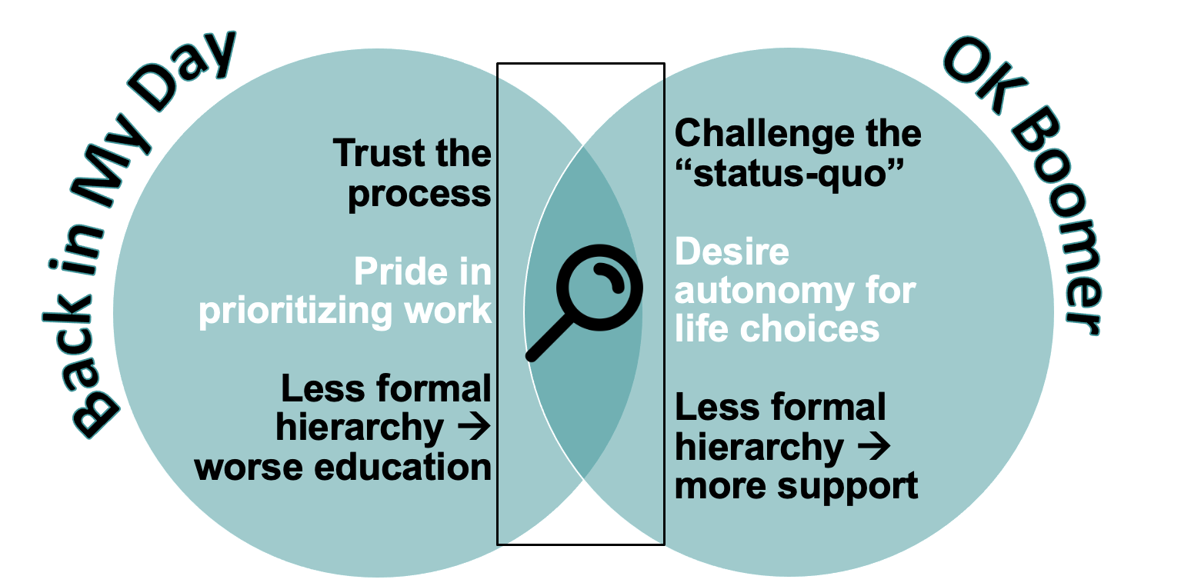
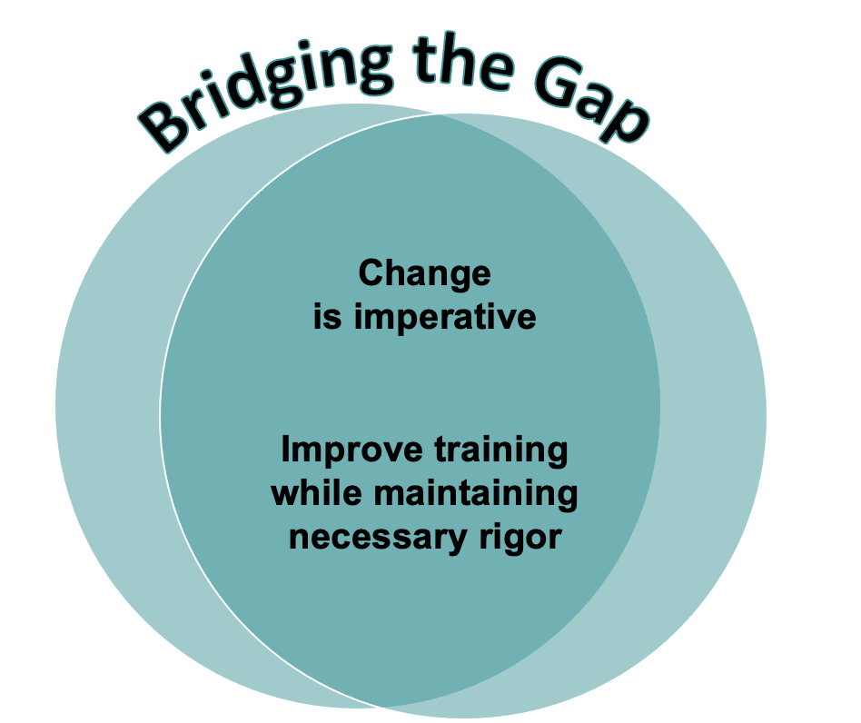
“Uphill in the snow both ways”
Shoveling a Path between Generations in the Surgical Environment
@BrookeTheOstomy
@The_SECONDTrial
Notes:
Questions

Slide 29




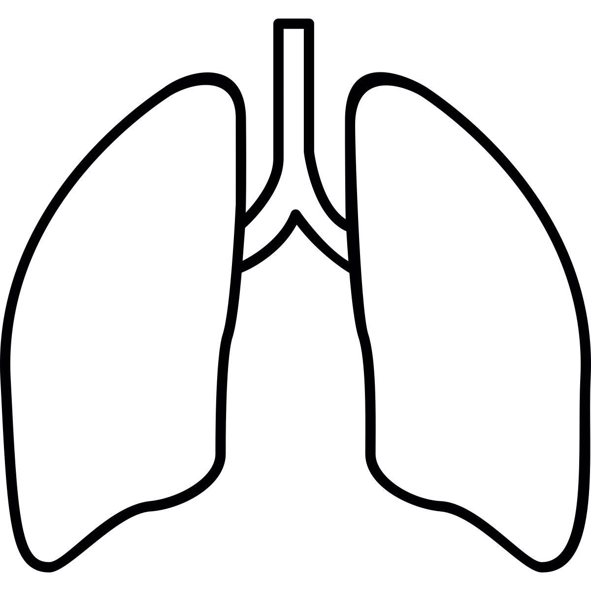
Study Objective
We sought to identify the differences in frequency and complication type
in M&M case submissions compared to NSQIP identified complications at a single institution
Notes:
Headings –can either be an overarching title or more specific
Font – headings >34, rest of text >20

Slide 30





Results
3911 cases performed by 38 surgeons were identified from the NSQIP database
485
(12.4%)
2239
(57.2%)
491
(12.6%)
225
(5.8%)
471
(12.0%)
Notes:
You can see top is 22 font

Slide 31
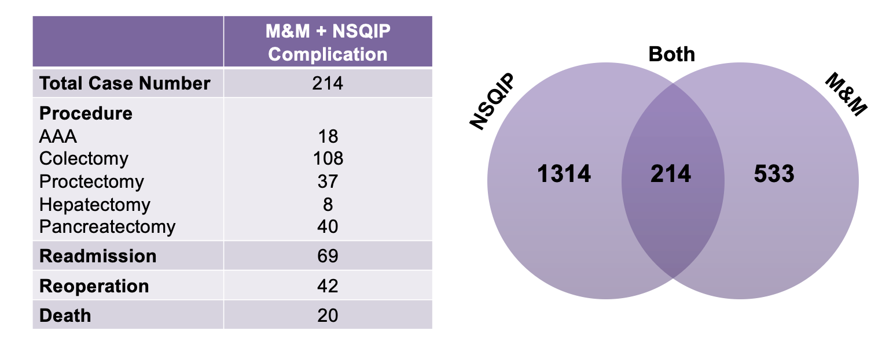
Case Overlap
NSQIP
1314
Notes:
Studies to date have compared the two databases separately. Novel to our study was merging the two databases in order to examine which cases were included as both an M&M and a NSQIP complication. After merge, we found only 214 cases were present in both databases.

Slide 32
Multivariable Analysis: Procedure
Post Discharge VTE Prophylaxis Adherence
 | No (n=1332) | Yes (n=2066) | OR, (95% CI)
Procedure type
Colorectal | 959 (44.1) | 1215 (55.9) | Ref
Hepato-pancreatico-biliary | 101 (29.4) | 243 (70.6) | 1.97, (1.53-2.54)
Urologic | 208 (41.9) | 289 (58.1) | 1.13, (0.92-1.38)
Gynecologic | 64 (16.7) | 319 (83.3) | 3.92, (2.92-5.27)

Slide 34
Limitations
Implementation changed to not mandatory mid-study
ISQIP contains hospitals participating in NSQIP or other QIP
Low frequency of cases at a few of the sites
Notes:
Our study should be interpreted within its limitations
Read line 1, which is why only 16 hospitals were evaluated
Read line 2 And thus there could be confounding initiatives
Read line 3, thus some of the large percentage changes is reflective of a small subset of patients

Slide 35

The New You
NQUIRES Northwestern Quality Improvement, Research, & Education in Surgery
Notes:
The reporting system varies between these two entities as well, with M&M being voluntary submissions through surgeon or trainee selection whereas NSQIP has trained surgical clinical reviewers who analyze specific cases and variables at assigned hospitals.

Slide 36
A Presentation
on How to Give
A Presentation
Kimberly B Golisch MD MS
Questions?
Notes:
Thank you for the opportunity to present our work

