Slide 1
Surgical Observation for FSM Students
Observation process for FSM Students

Slide 2
Observer Process
FSM Students by way of DOS will receive the ‘one page approval’; scrub pin instructions; ORSC contact; locations of ORs; surgeon /assistant for areas of interest. There are no restrictions if process is followed, however ORSC (Operating Room Surgical Coordinator) will limit to two observers in a case.
If student does not know a surgeon in the field of interest the Dept of Surgery (kelsey.riley@nm.org) creates a match.
Determine observation date – surgeon, assistant, & student
2016 Internal Observer Form
Student sends to: ORSC Nurse
Timeline: 48 hours
ORSC Approval / permission granted
FSM student

Slide 3
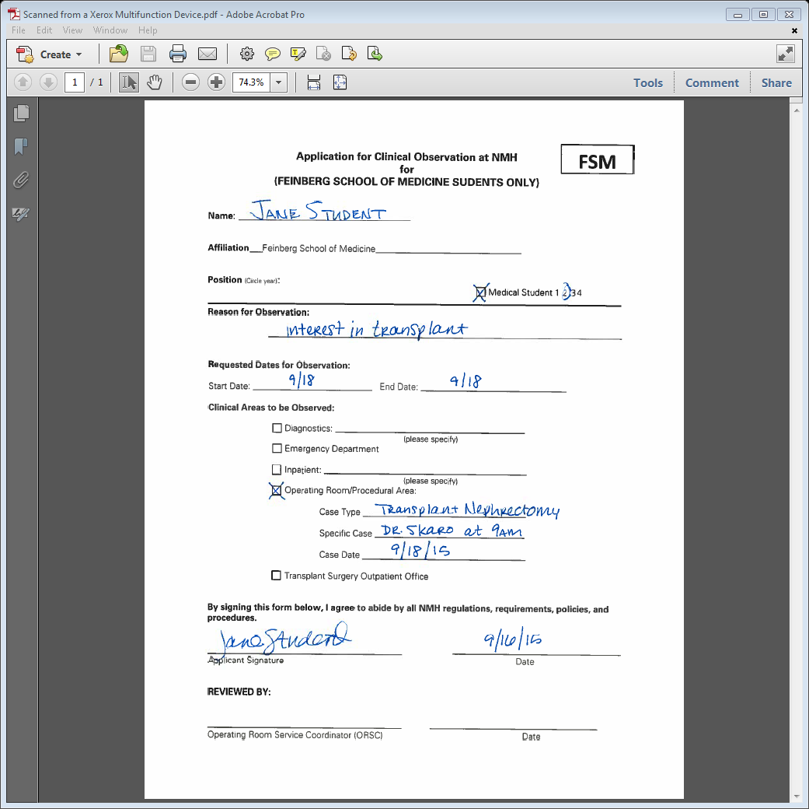
Always required

Slide 4
send to:
FSM Student will need to complete the one page “2016 Internal Observer” form and submit via email to the appropriate ORSC Nurse 48 hours prior to case
Service | ORSC Name | Email | Contact Information
ENT/Plastics | Deborah Dickens | ddickens@nm.org | 6-2080/2-8382
Orthopaedics | Nicole Gee | ngee@nm.org | 6-1899
Spine | Sarah Leroux | sjacobse@nm.org | 2-8380
Neurosurgery | Meghan Costello |  | 6-7709
Urology | Kristina Rodriguez | krodrigu@nm.org | 6-0753
General Surgery | Rowena Martinez | rtmartin@nm.org | 6-6263
Vascular & Thoracic | Lynn Borgini | lborgini@nm.org | 6-9625
Transplant | Renee Ziomek | rziomek@nm.org | 6-8255
Cardiac | Maggie Simons | msimons@nm.org | 6-9338
Eye | Amelia Balinao | abalinao@nm.org | 6-9730
Sports (Ortho/Hand/General) | Gayle Malacat (Ma Gazelle) | mmalacat@nm.org | 6-5148
Gynecology | Melanie Silos | msilos@nm.org | 2-3542
Breast & Plastics | Renetta Rotroff | rrotroff@nm.org | 2-3544

Slide 5
Extra Notes:
Scrubs: Be aware that you cannot observe in the OR unless you are in OR scrubs. Please make sure that you have obtained access to OR scrub dispenser prior to the day of the observation. Before attempting to enter to OR area, make sure you are dressed in proper OR attire: i.e. scrubs, an OR hat, and an OR mask. Please wear your scrubs and comfortable shoes as you will be standing for a long time. No long sleeves under the scrubs, so please wear a short sleeve tee. Make sure to bring your NMH badge, cell phone and minimal items, as there is no secure place for you to store them.
FSM Student – prior to observation (3 days) contact Linda Daniels, l-daniels2@northwestern.edu
Scrub Machines
4th floor Olson Pavilion
6th floor Feinberg Pavilion
6th floor Prentice Women's Hospital
9th floor Prentice Women's Hospital
Since the OR schedule frequently changes, check the OR schedule on the day of your planned observation, to reconfirm the proposed time and room # of your case. Feinberg Control room 6-5150
Feinberg ORs
# 1-27 are on 5th Floor
# 30-37 are on 7th Floor
**As an observer please do not touch anything, stay out of everyone’s way, and if you feel faint at all step outside the operating room, or sit for a little. When you arrive please introduce yourself to the nurse coordinator. They will take down your name and request to see your badge, then then guide you on where to stand for optimal viewing.
**We strongly recommend that you work with the attending to identify a contact person who you can get in touch with prior to your OR experience who can help guide you through the observation experience including: informing you as to when the OR is actually going to happen, orienting you to the OR environment, introducing you to the OR personnel, and ensuring that you are shown the proper way to scrub your hands and to practice sterile technique in the OR, etc.
This contact person could be the attending himself/herself, the attending’s resident or Physician’s Assistant, the OR nurse, or someone else. Please confirm with the attending surgeon who they recommend would be the best contact person for the case you are planning to participate in. Contact this person a day or two before the planned surgery to make them aware you may be contacting them on the day of the surgery and to ensure that you have their correct contact info.

